Slide 1
Moving Beyond Linearity
© 2025 Virginia Polytechnic Institute and State University. All rights reserved.

Slide 2
At the end of this module, you should be able to:
Identify types of non-linear models
Describe the general idea behind each of the common non-linear models
Identify when you might use each type of non-linear model
Explain what is meant by general additive model
Implement common non-linear model methods in Python

Slide 3
Moving Beyond Linearity

Slide 4
Introduction to Machine Learning Course Roadmap
What is the goal of the data analysis?
Predict an output |  |  |  |  |  | Reveal patterns or relationships |  | Make decisions using an autonomous agent
Supervised Learning (Output in the data set) |  |  |  |  |  | Unsupervised Learning (No output in the data set) |  | Reinforcement Learning* (Supervised & unsupervised)
Continuous or discrete output? |  |  |  |  |  | What is the subgoal? |  | Does a model exist?
Continuous |  |  | Discrete |  |  | Identify groups | Reduce dimensions | Model Based | Model Free
Simple linear regression Multiple linear regression Subset selection Ridge regression & LASSO PCR & PLS | Polynomial regression Step functions Splines Local regression General additive models | Decision tree Random forest Neural network Gradient boosting tree | Logistic regression Linear discriminant analysis Quadratic discriminant analysis | Decision tree Random forest Neural network Gradient boosting tree | Support vector machines | Hierarchical clustering K-means clustering | Principal components analysis | Given the model Learn the model | Policy Optimization Q-Learning
Polynomial regression
Step functions
Splines
Local regression
General additive model
*Advanced Topic: Bonus module if time
Notes:
In the previous module, we reviewed concepts related to improving the linear regression model. We are now going to move beyond linearity and look at a set of nonlinear modeling techniques

Slide 5
Supervised versus unsupervised again
Some tangible measurement(s)
“The Black Box”
INPUTS
MACHINE LEARNING MODEL
OUTPUT(S)
Supervised Learning
In the context of domain knowledge
“The Black Box”
INPUTS
MACHINE LEARNING MODEL
PATTERNS,
RELATIONSHIPS, STRUCTURE
Unsupervised Learning
does it make sense?
Notes:
We want to provide you with some context of where nonlinear methods fits into the larger scheme of machine learning. (click) Nonlinear methods are supervised learning models. We need to have an outcome.

Slide 6
Supervised learning method selection is based on the response type
Is my response quantitative or qualitative?
Age
Height
Income
Stock Price
Tensile Strength
Quantitative
Qualitative
Blood Type
Default on Debt (y/n)
Cancer Stage
Brand Purchased
Species
Typically use regression method
Typically use classification method
Discrete: Nominal or Ordinal
Continuous Measures
What about the predictors?
For most methods, predictors can be
either quantitative or qualitative.
Notes:
We will be focused on regression methods with a continuous or quantitative response

Slide 7
Two methods of estimation
Parametric
(Less Flexible, More Interpretable)
Non-parametric
(More Flexible, Less Interpretable)
Inference focused
Select a model which involves an assumption about the functional form of f. Train the model and estimate parameters.
Example:
f is linear in X: f(X) = β₀+β₁X₁ + β₂X₂ +…+ β_{p}X_{p}
Prediction focused
Does not make explicit assumptions about the functional form of f. Can fit wider range of possible shapes for f, but at that cost of needing a larger number of observations.
Example:
Splines
Notes:
Nonlinear methods can be both parametric and nonparametric. We will start with parametric models like polynomial regression and work are way up to nonparametric methods like splines

Slide 8
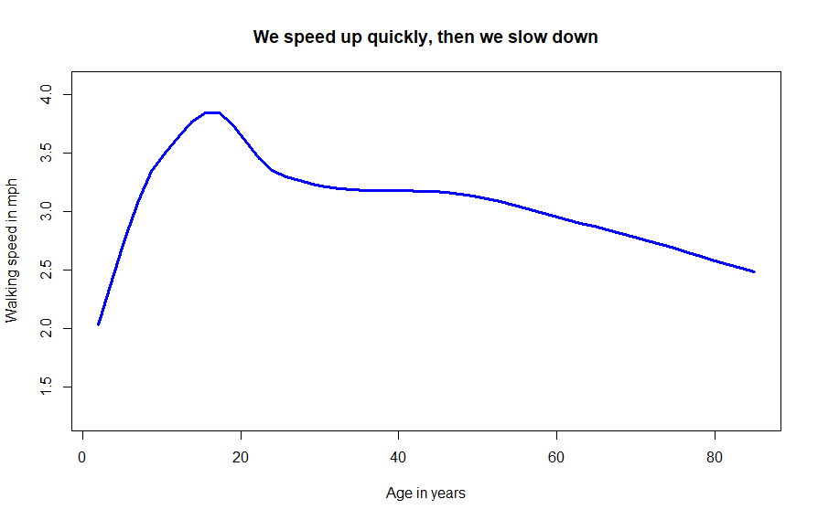






Some relationships are just not linear
Notes:
Note: This slide is animated. Pictures appear one at a time on click.

Slide 9
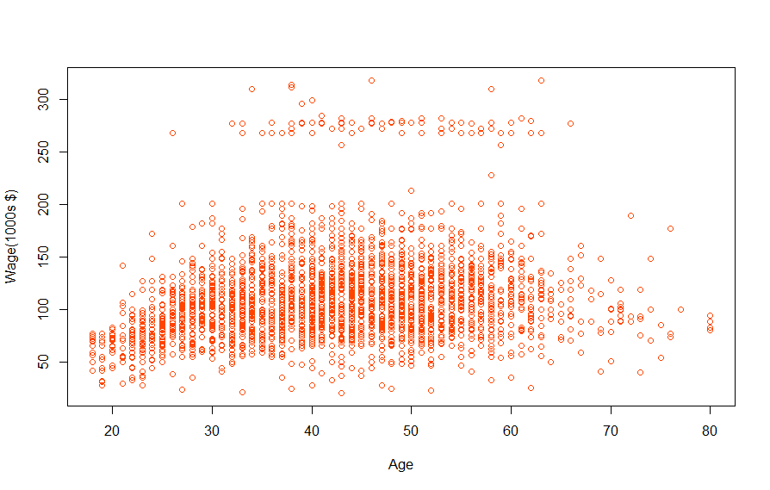
Age and wage may not be linearly related
Mid-Atlantic Wage Data: 3000 male workers in the Mid-Atlantic region, 2003-2009
year: Year that wage information was recorded
age: Age of worker
marital: a factor with 5 level indicating marital status
race: a factor with 4 levels
education: a factor with 5 levels
region: Region of the country (mid-Atlantic only)
jobclass: a factor with 2 levels
health: a factor with 2 levels
health_ins: a factor with 2 levels
logwage: Log of workers wage
wage: Workers raw wage

Slide 10
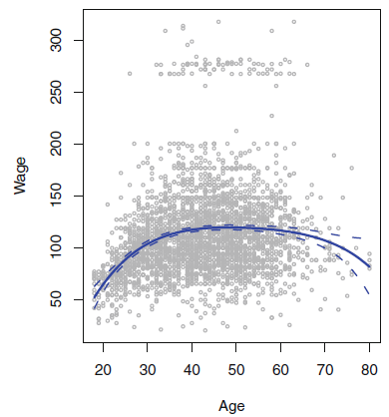
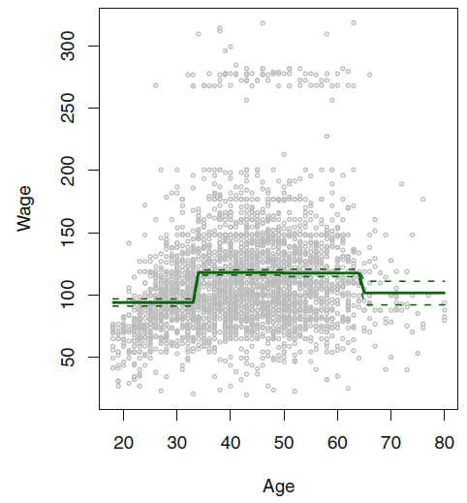
Different types of non-linear models
Polynomial Regression
Step Functions
Notes:
Polynomial regression is a simple way to extend linear regression to a non-linear situation. It is based on adding extra predictors to the model that are obtained by raising the original predictor to a power, for example, 2, 3, 4 power. Typically, would be unusual to go beyond degree 3 or 4 because the curve becomes overly flexible and could take an unusual shape.
Left graph: The solid blue curve is a degree-4 polynomial of wage (in thousands of dollars) as a function of age, fit by least squares. The dashed curves indicate an estimated 95 % confidence interval.
Step functions we break the range of X into bins, and fit a different constant in each bin. This amounts to converting a continuous variable into an ordered categorical variable. We then use linear regression. Unless there are natural breakpoints in the predictors, piecewise-constant functions might not really capture what is going on
Right graph: The solid curve displays the fitted value from a least squares regression of wage (in thousands of dollars) using step functions of age. The dashed curves indicate an estimated 95 % confidence interval. The fit is a piecewise constant function. Note that the first bin misses the increasing trend of wage with age

Slide 11
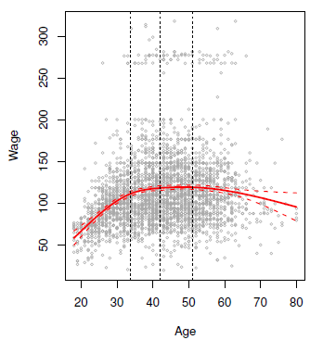
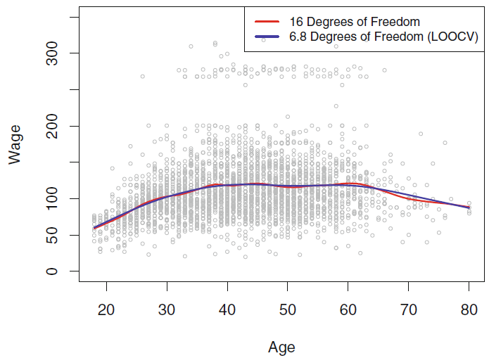
Different types of non-linear models
Regression Splines
Smoothing Splines
Notes:
Regression splines are an extension of polynomials and step functions. They involve dividing the range of X into K distinct regions. Within each region, a polynomial function is fit. However, these polynomials are constrained so that they join smoothly at the region boundaries, or knots. We can get a very flexible fit with this approach.
Left graph: The cubic polynomials are constrained to be continuous, and to have continuous first and second derivatives. In general a cubic spline with K knots uses a total of 4+K degrees of freedom
Smoothing splines are similar to regression splines, but they result from minimizing a residual sum of squares criterion subject to a smoothness penalty.

Slide 12
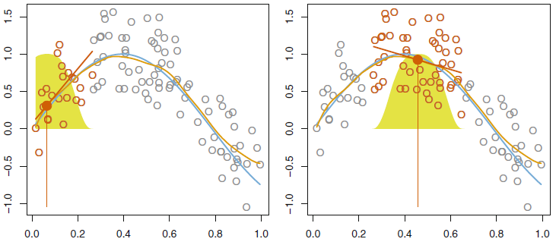
Different types of non-linear models
Local Regression
Notes:
Local regression is similar to splines, but differs in an important way. The regions are allowed to overlap, and do so in a very smooth way.

Slide 13
Different types of non-linear models
Smoothing Splines
Local Regression
Polynomial Regression
Generalized Additive Models (GAMs)
Regression Splines
Step Functions
Notes:
Generalized additive models allow us to extend the methods above to deal with multiple predictors.

Slide 14
Moving Beyond Linearity

Slide 15
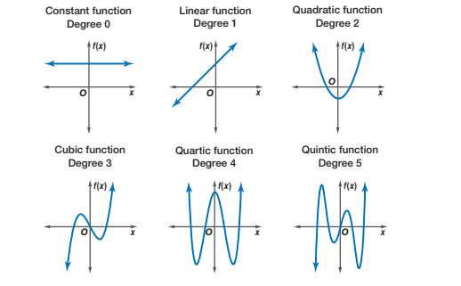

Higher order terms add curvature
Simple Linear Regression
Polynomial Regression
Higher degree $⇒$ More curvature
Notes:
Notes:
How do we add non-linearity to our model?
Add higher order terms
SLR uses constant and degree 1 terms
Polynomial regression uses higher order (degree 2, 3, 4, +)
The higher the degree, the more curvature it can add to the model
Reference for picture: https://en.wikiversity.org/wiki/Algebra_II/Polynomial_Functions

Slide 16
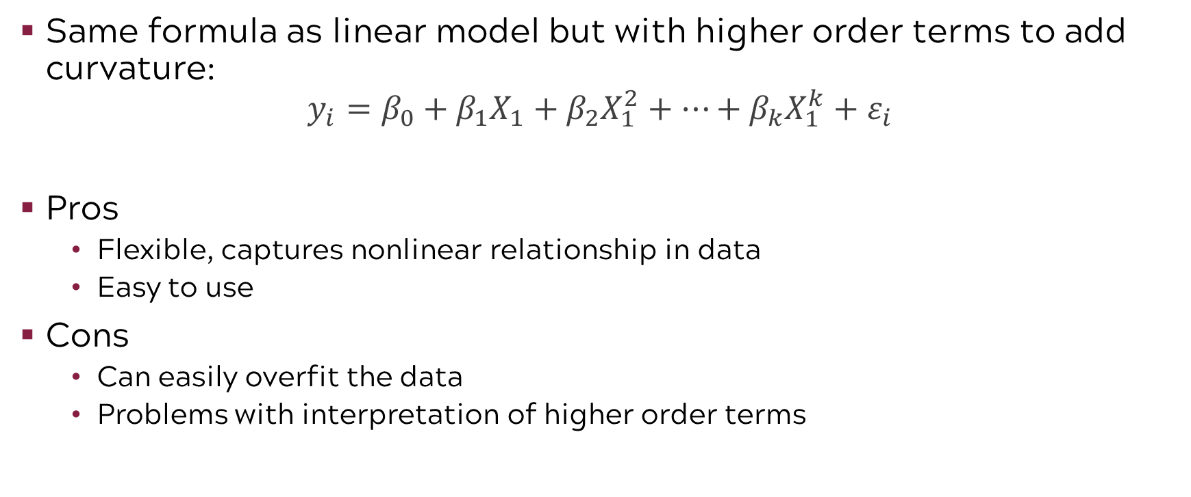
Polynomial regression
Same formula as linear model but with higher order terms to add curvature:
$$y_{i}=β_{0}+β_{1}X_{1}+β_{2}X_{1}^{2}+⋯+β_{k}X_{1}^{k}+ε_{i}$$
Pros
Flexible, captures nonlinear relationship in data
Easy to use
Cons
Can easily overfit the data
Problems with interpretation of higher order terms
Notes:
Notes:
Polynomial regression is the first model we’ll discuss that goes beyond linear structure
Polynomial regression same formula as SLR but with higher order terms
Notice, the model on the right looks different than the straight line we’d get from SLR, has curvature
Some pros of Polynomial regression:
More flexibility than SLR, captures nonlinear relationship in data
Some cons of polynomial regression:
Can easily overfit the data causing interpolation/extrapolation problems, possibly even “perfect” fits
Interpreting higher order terms can be difficult or impossible
Picture taken from course textbook

Slide 17
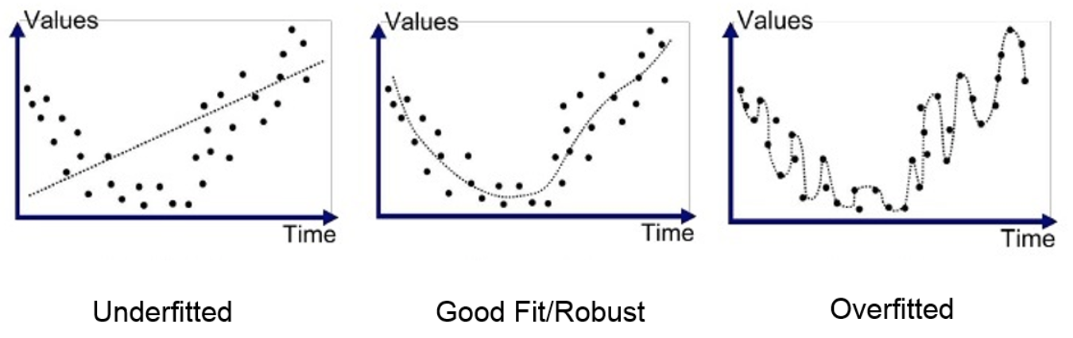
Be careful not to overfit!
Flexibility
Interpretability
And vice versa!
Notes:
Notes:
As mentioned in the previous slide, it can be easy to overfit the data with polynomial regression by adding too many higher order terms.
Rarely use terms above cubic and quartic terms can become too flexible and take on weird shapes to perfectly fit the data you have
In general, we want a model that can capture the overall curvature of the data we have without bending/molding to the points too much.
Reference for picture: https://binarycoders.dev/2019/10/17/ml-python-vii-overfitting-underfitting/

Slide 18
Moving Beyond Linearity

Slide 19
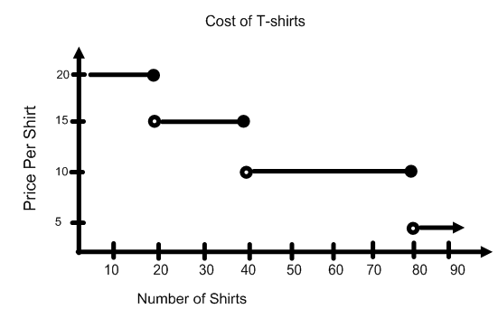
Step functions
Step functions take on different numeric constants for binned or grouped values of X
Example: Buying t-shirts in bulk for an event, cost per shirt drops at different values of X
Notes:
Notes:
What if the linear relationship or curvature is different in different parts of the data? This is where the concept of step functions come in handy.
In general, step functions take on a different numeric constant for binned or group values of X.
Consider a very basic example of buying T-shirts in bulk for an event. Say the price per shirt decreases as you buy more shirts, but not at a continuous rate. The cost per shirt drops at different values of X.
- We see this type of function in lots of places, like income tax brackets, and the cost of shipping packages based on weight or dollar amount purchased.
References for pictures: https://www.algebra-class.com/step-functions.html

Slide 20
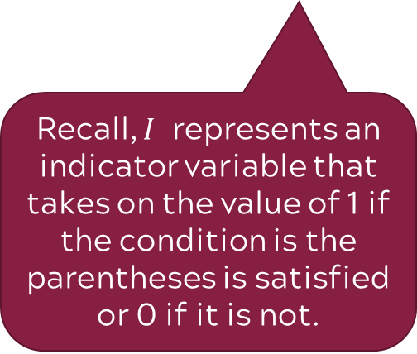
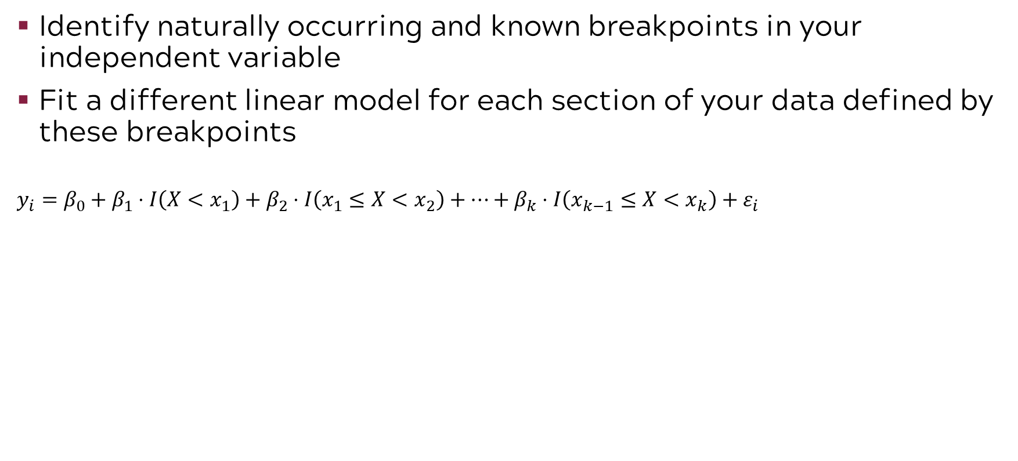
Modeling with step functions
Identify naturally occurring and known breakpoints in your independent variable
Fit a different linear model for each section of your data defined by these breakpoints
$$y_{i}=β_{0}+β_{1}⋅I\left(X<x_{1}\right)+β_{2}⋅I\left(x_{1}≤X<x_{2}\right)+⋯+β_{k}⋅I\left(x_{k−1}≤X<x_{k}\right)+ε_{i}$$
Recall, $I$ represents an indicator variable that takes on the value of 1 if the condition is the parentheses is satisfied or 0 if it is not.
Breakpoints must be set by the analyst
Notes:
Notes:
We can incorporate step functions into our models to assign different coefficient values to observations within grouping of x values.
First, you need to decide how to break your independent variable into sections. This needs to be done using naturally occurring and known breakpoints.
Then fit a different model for each section of the data defined by those breakpoints.
For example, with our wage data, we may believe that wages tend to increase, on average, around age 33 due to promotions and raises and then drop again at age 65 for retirement. We can use these ages as breakpoints for our step function and then model these age groups differently, as seen in our picture here.
Picture taken from course textbook

Slide 21
Moving Beyond Linearity

Slide 22
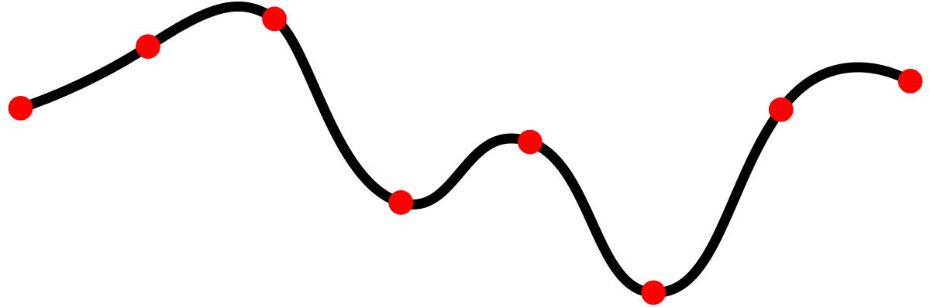
Splines
Piecewise functions of different polynomials “tied together” using knots
As a model class: a combination of polynomial regressions and step-functions
Knots
Different Polynomials
Notes:
Notes:
Splines are a type of function. They are piecewise functions or different polynomials “tied together” using knots
The knots are the natural breakpoints in our data, similar to what we saw with step functions
As a model class, they can be thought of as a combination of polynomial regression and step-functions
This allows for a greater amount of flexibility in your model
Go through detail of different polynomials for each section. For example linear may fit well in first section, quadratic in second, etc.
Reference for picture: https://de.wikipedia.org/wiki/Spline-Interpolation

Slide 23
Modeling with regression splines
Select the knots (or breakpoints) in your independent variable
Fit a different regression model for each section of your data defined by these knots
Polynomials must connect at each knot – no discontinuity!
Cubic Spline
Notes:
Notes:
To model using regression splines, you first need to select the knots to use as breakpoints in your model
Then fit a different regression model for each section of your data defined by these knots
The major difference between using step functions and regression splines is that the different pieces must connect, or be “tied together”, we will not have any discontinuities
There are many different types of splines, but the most common and the one applied in this course is the cubic spline. Refer to text for info about other splines
Text for Figure 7.3 from ISLP book “The general definition of a degree-d [regression] spline is that it is a piecewise degree-d polynomial, with continuity in derivatives up to degree d – 1 at each knot. Therefore, a linear spline is obtained by fitting a line in each region of the predictor space defined by the knots, requiring continuity at each knot.”
Picture taken from course textbook

Slide 24
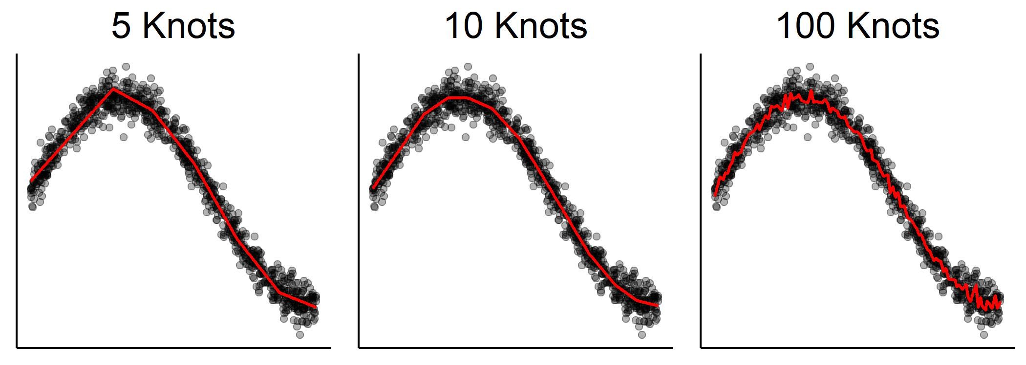
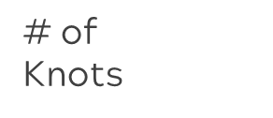
How many knots?
Knots typically placed at uniform quantiles of the data
Example: If you want 3 knots, place at 25th, 50th, and 75th quantiles of independent variable
Use cross-validation to select the number of knots that results in the lowest overall cross-validated RSS
# of
Knots
Flexible
Notes:
Notes:
How do we choose the knots?
Typically placed along uniform quantiles of the independent variable
For example, if you want 3 knots, place them 25th, 50th, and 75th quantiles
As for the number of knots, you can use cross validation to fit splines with different numbers of knots and then select the number of knots that resulted in the lowest overall cross validated RSS
We can see in the picture that with only 5 knots, this particular spline is jagged, but follows the data. With 10 knots, the model appears to be more smooth and form a curve. However, jumping to 100 knots, the line is very bumpy.
As the number of knots goes up, we get more flexibility in our model. But too much flexibility can cause overfitting.

Slide 25
Moving Beyond Linearity

Slide 26
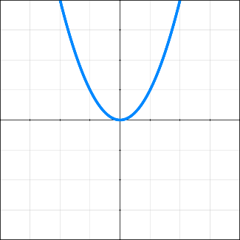
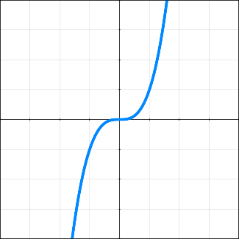
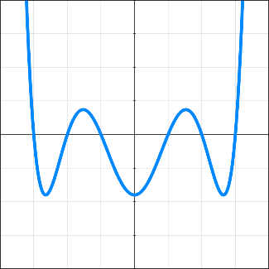
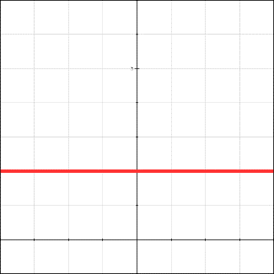
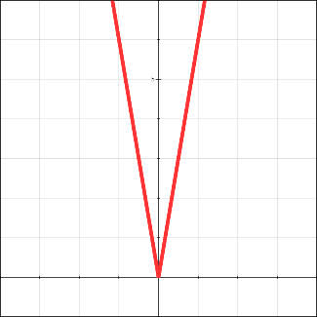
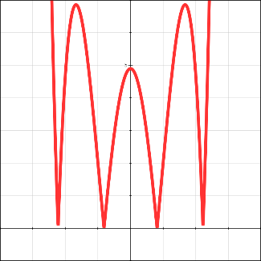
Smoothness of a function
We want a flexible and smooth model
Conceptually, the 2nd derivative of a function measures its “smoothness”
Quadratic
Cubic
6th Degree
Function
|2nd Derivative|
Smoothness
|2nd Derivative|
Notes:
Notes:
Ideally, we want a model that is flexible and smooth
How do we determine if a function is smooth?
The 2nd derivative is (loosely) a measure of the function’s “smoothness”
A bigger (in absolute value / magnitude) 2nd derivative means the function is more “rough”, or less “smooth”

Slide 27
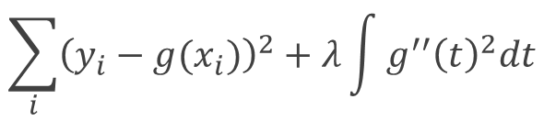
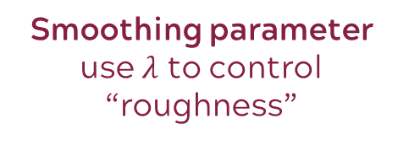
Smoothing splines
We want a flexible and smooth model
Place knots at each unique observation of the independent variable
Penalize the model for being too “rough” using the 2nd derivative
$$\sum_{i}{{\left(y_{i}−g(x_{i})\right)}^{2}+λ\int{g^{′′}{\left(t\right)}^{2}dt}}$$
Smoothing parameter use $λ$ to control “roughness”
Notes:
Notes:
Smoothing spline combine the ideas of both flexibility and smoothness
For flexibility, we place a knot at each unique observation of the independent variable
To ensure smoothness, we penalize the model for being too “rough” by using the second derivative
We are still fitting different models to different parts of the data, know just smaller portions of the data and “smoothing” these pieces with a smoothing parameter lambda
This formula here may look familiar, it is similar to ridge regression and lasso but with a different penalty term
Red line in graph represents model with 16 degrees of freedom
Blue line is model from LOOCV with only 6.8 degrees of freedon

Slide 28
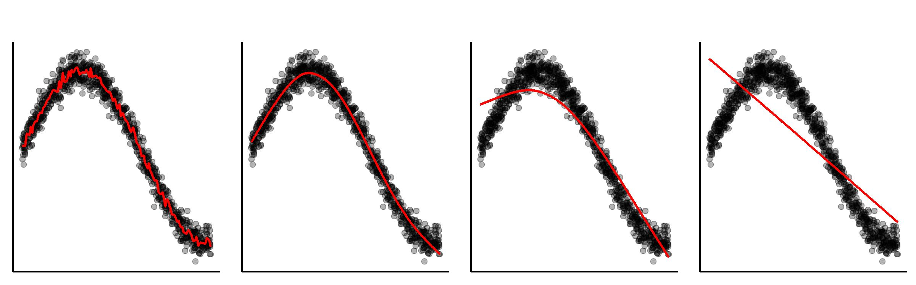
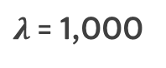
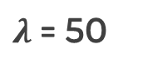
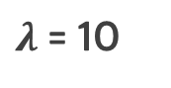

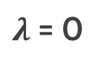

Choosing the smoothing parameter $λ$
Use cross-validation to select the 𝜆 value that results in the lowest overall cross-validated RSS
$λ$= 0
$λ$= 10
$λ$= 50
$λ$= 1,000
$$λ$$
Smoothness
Notes:
Notes:
With smoothing splines, we no longer have to worry about how many knots we should choose. Instead, we need to choose lambda, the smoothing parameter.
Lambda governs how rough the function can be
Again, cross validation can be used to select the lambda value that results in the lowest cross-validated RSS
The smaller lambda is, the more “rough” the function tends to be. The larger lambda, the more smooth it is.
This can be taken to the extreme. When lambda is very large, the model is essentially forced to fit a simple linear regression to maintain smoothness, which usually defeats the purpose of using splines to begin with.

Slide 29
Moving Beyond Linearity

Slide 30
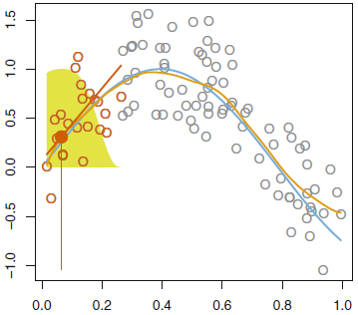
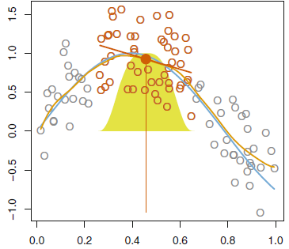
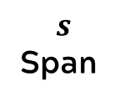

Local regression
$$s$$
Span
…
…
$$x_{0}$$
Target point
Local Regression estimate
True Data Generating Process
Weights
Notes:
In local regression, we fit multiple linear models, where for each model we allow nearer points to influence the model more.
Local regression illustrated on some simulated data, where the blue curve represents f(x) from which the data were generated, and the light orange curve corresponds to the local regression estimate ˆ f(x). The orange colored points are local to the target point x0, represented by the orange vertical line. The yellow bell-shape superimposed on the plot indicates weights assigned to each point, decreasing to zero with distance from the target point. The fit ˆ f(x0) at x0 is obtained by fitting a weighted linear regression (orange line segment), and using the fitted value at x0 (orange solid dot) as the estimate ˆ f(x0).
Span=s is the proportion of points used to compute the local regression at x0. s plays a role like the tuning parameter; it controls the flexibility of the nonlinear fit The smaller the value of s, the more local and wiggly will be our fit; alternatively, a very large value of s will lead to a global fit to the data using all of the training observations. We can again use cross-validation to choose s, or we can specify it directly. The larger s is, the smoother the fit

Slide 31
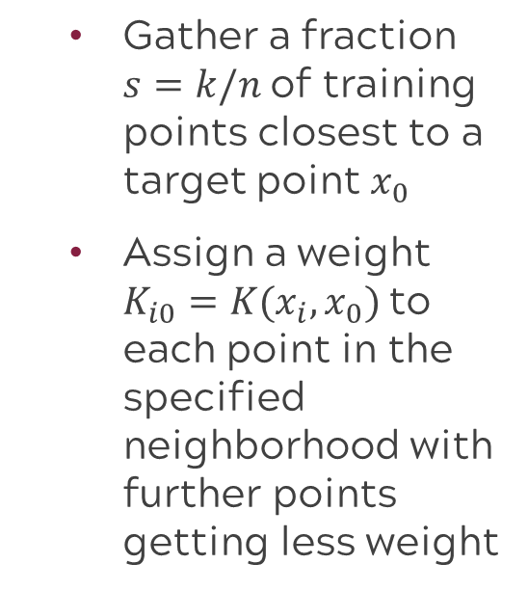
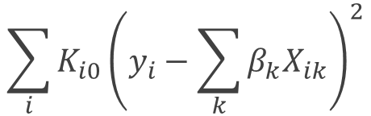
Building the local regression model
Gather a fraction $s=k/n$of training points closest to a target point $x_{0}$
Assign a weight $K_{i0}=K(x_{i}, x_{0})$to each point in the specified neighborhood with further points getting less weight
Fit a model using our weights:
$$\sum_{i}{K_{i0}{\left(y_{i}−\sum_{k}{β_{k}X_{ik}}\right)}^{2}}$$
Local Regression estimate
True Data Generating Process
Weights
Notes:
Note that the weights Ki0 will differ for each value of x0.
Span=s is the proportion of points used to compute the local regression at x0. s plays a role like the tuning parameter; it controls the flexibility of the nonlinear fit The smaller the value of s, the more local and wiggly will be our fit; alternatively, a very large value of s will lead to a global fit to the data using all of the training observations. We can again use cross-validation to choose s, or we can specify it directly. The larger s is, the smoother the fit
Points closer to the target are more heavily weighted in the weighted least squares regression
Tri-weight or tri-cube weight is classic LOESS (locally estimated scatterplot smoothing)
Other weight functions are possible as long as they satisfy the following conditions:
Symmetry: W(x, t) = W(−x, t) (weighting only depends on distance, not direction).
Non-negativity: W(x, t) ≥ 0 for all x and t > 0.
Monotonicity: for each t > 0, W(x, t) is decreasing for all x > 0 (distant points have less weight than closer points).
Bounded: W(x, t) ≤ K for all (x, t) for some fixed K > 0. (Typically, we would want K = 1).
Tri-weight or tri-cube (classic LOESS):$W\left(u\right)={\left(1−{\left|u\right|}^{3}\right)}^{3}$ or alternatively $W\left(x,t\right)=\left\{\begin{matrix}{\left(1−{{\left|x\right|}^{3}}/{t^{3}}\right)}^{3} for 0≤\left|x\right|≤t \\ 0 for \left|x\right|>t\end{matrix}\right.$
With a window length λ, then the function W(x − x0, λ) will give maximum weight for x = x0, that is W(0, λ) = 1, while giving less and less weight as x moves further away from x0. The weight becomes 0 once x has a distance of λ or more from x0
R options https://www.rdocumentation.org/packages/McSpatial/versions/2.0/topics/lwr

Slide 32
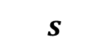
The span, s, controls the flexibility of the fit
s is similar to the tuning parameter 𝝀 in smoothing splines
We can use cross-validation to select s or specify the value
$$s$$
Smoothness
Notes:
Span = bandwidth = Length of sliding window acts as a smoothing parameter
It controls the flexibility of the non-linear fit. The smaller the value of s, the more local and wiggly will be our fit; alternatively, a very large value of s will lead to a global fit to the data using all of the training observations. We can again use cross-validation to choose s, or we can specify it directly.
under-smoothing: The span is too small, which results in extremely wild and jagged fits. The result is typically a poor representation of the underlying process (principal of parsimony).
over-smoothing: The span is too large, which results in ‘too smooth’ of a fit that does not capture the trend in the data. This may capture a global trend well, but loses the fine details for portions of the data.
Figure 7.10 displays local linear regression fits on the Wage data, using two values of s: 0.7 and 0.2. As expected, the fit obtained using s = 0.7 is smoother than that obtained using s = 0.2.

Slide 33
Moving Beyond Linearity

Slide 34
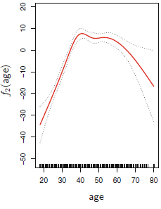
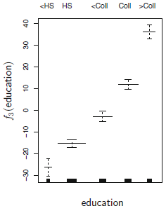
General additive models allow different methods for each variable
Regression Splines
Step Functions
Notes:
GAMs allow us to combine all of the models we just showed in addition to others into one model by using different methods for each variable. For example, we can incorporate regression splines into f_2, a function of age. Or we can incorporate a step function into f_3, a function of education.

Slide 35
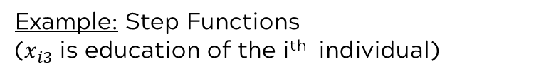
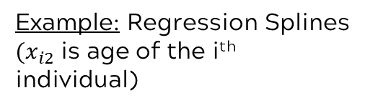
Combined final model
$$y_{i}=β_{0}+f_{1}\left(x_{i1}\right)+f_{2}\left(x_{i2}\right)+f_{3}\left(x_{i3}\right)+⋯+f_{k}\left(x_{ik}\right)+ε_{i}$$
Contribution of variable modeled using any of the methods we’ve shown.
Example: Regression Splines
${(x}_{i2}$ is age of the i^{th} individual)
Contribution of variable modeled using any of the methods we’ve shown.
Example: Step Functions
($x_{i3}$ is education of the i^{th} individual)
Notes:
Then we can combine these components in our final model. The contribution of each variable is modeled using any of the methods we’ve shown.

Slide 36
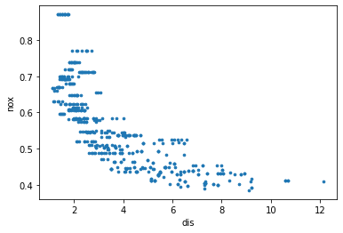
Exercise: Predicting nitrogen oxide (NO₂) concentration in the air
Dataset: Boston.csv
Objective: To explore the use of polynomial regression and regression splines
Dependent Variable: Nitrogen oxide (NO₂) concentration in the air in parts per 10 million (nox)
Independent Variable: Distance from an employment center (dis)
Notes:
Recall the dataset we used earlier for predicting crime rates. We can use the same dataset to make predictions about different variables. This time, we will explore the use of polynomial regression and regression splines for predicting nitrogen oxide (NO₂) concentration in the air using a single variable, distance from an employment center.
In this exercise, we use the Boston data set, which is part of the ISLP package. We will use two columns from this data: dis (the weighted mean of distances to five Boston employment centers) and nox (nitrogen oxides concentration in parts per 10 million). We treat dis as the predictors and nox as the response. Let's start by reading in the data and taking a look at a summary of the columns we're interested in.

Slide 37
ML paradigm to evaluate model performance
Test Error: average error that results from using a machine learning method to predict the response on data that was not used in training the method
Models are built to do well on the data they’ve been fed. We want to ensure they also do well on data they haven’t encountered.
Whole Sample
Randomly
divide
Training set
Fit
Model
Prediction
Validation set
Tune
Test
Test Error
Test set
Notes:
Before we jump into the exercise, recall the ML paradigm to evaluate model performance with test error
A common way to evaluate its performance in this paradigm is through test error. The model is used to make predictions on the test set, which the model has not yet “seen”, and from these predictions we can get test error. Test error is the average error that results from using a machine learning method to predict the response on data that was not used in training the method. Remember, the model was only built using the training and validation sets, thus it was built to do well on that data. We want to ensure the model will also do well on new data, which is why a test set is used.
Recall for the purposes of this course, we will limit ourselves to training and test (exclude validation)

Slide 38
Code road map
1) Import Modules + Packages
2) Visualize Data
3) Build Training + Test Datasets
4) For each model:
Fit model with training data
Generate predicted labels
Evaluate performance
Notes:
Also recall our code rode map

Slide 39
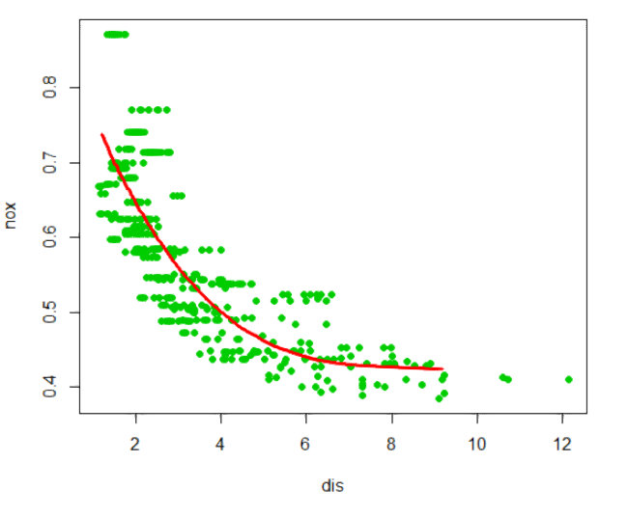
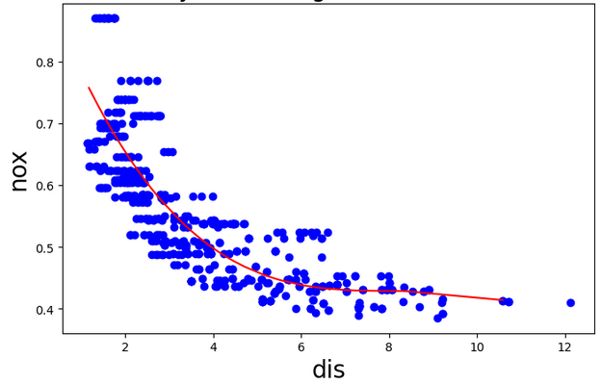
1) We will begin with a cubic polynomial regression
R Code
BosLM <- lm(nox~poly(dis,3), data=trainBoston)
Polynomial regression using 3 degrees (cubic fit)
Python Code
Defining a 3rd degree polynomial
poly_dis = MS([poly('dis’, degree=3)]).fit(boston_train)
M = sm.OLS(y_train, poly_dis.transform(boston_train)).fit()
Fitting the defined polynomial regression
Notes:
It seems we’re plotting all of the data but overlaying the fitted polynomial regression curve based on just our training set.

Slide 40
2) Now we’ll try out different degree polynomial regressions
R Code
for(i in 1:10){
BosLMIter <- lm(nox~poly(dis,i), data=Boston)
BosPRMRSS[i] <- sum(summary(BosLMIter)$residuals^2)
dissort <- data.frame(dis=sort(Boston$dis))
BosLMPredIter <- predict(BosLMIter, dissort)
}
Polynomial regression using degrees from 1 to 10
Python Code
Polynomial regression using degrees from 1 to 10
for i in range(1, 11):
poly_dis = MS([poly('dis', degree=i)]).fit(boston)
M = sm.OLS(y, poly_dis.transform(boston)).fit()
preds = M.predict(exog=poly_dis.transform(boston))

Slide 41
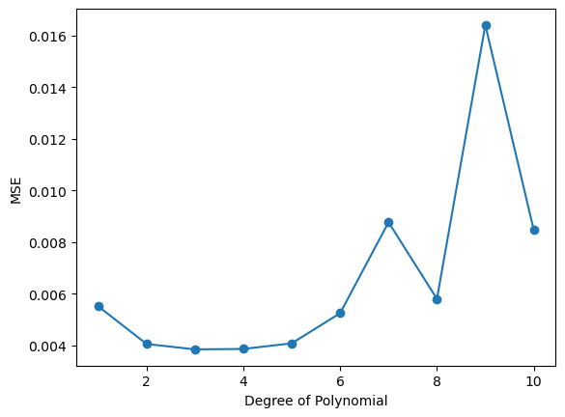
Comparing the test MSE values, the 3rd order polynomial appears to be the best

Slide 42
3) Next we try the regression spline approach with 1, 2, and 3 knots (code shown for 2)
R Code
Fitting spline with 2 knots
BosSp2 <- lm(nox~bs(dis, knots=c(2.1,3.21)), data=Boston)
BosSp2Pred <- predict(BosSp2, Boston, se=TRUE)
Predicting
Python Code
Fitting spline with 2 knots
bs_dis2 = MS([bs('dis’, internal_knots=[2.1, 3.21], name='bs(dis)')])
Xbs = bs_dis2.fit_transform(boston)
M = sm.OLS(y, Xbs).fit()
preds = M.predict(exog=bs_dis2.transform(boston))
Predicting

Slide 43
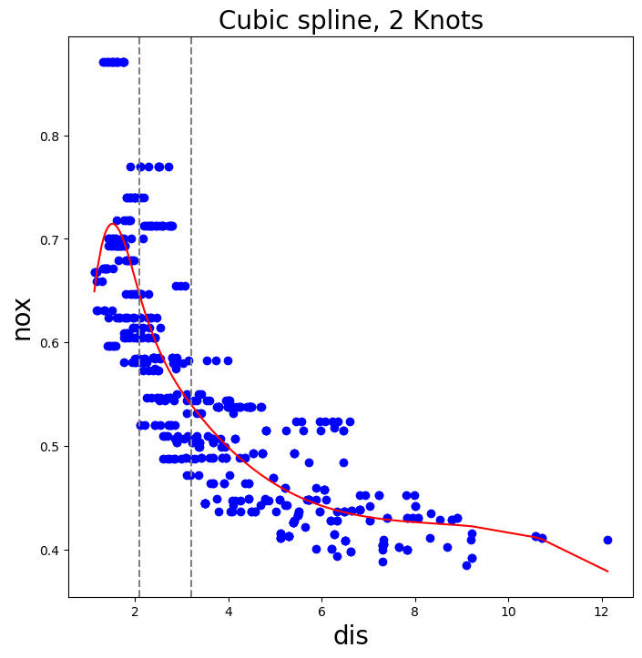
Cubic spline with 2 knots

Slide 44
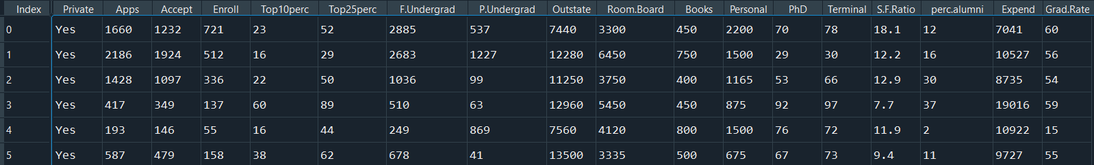
Exercise: Predicting out of state tuition
Dataset: College.csv
Objective: To make predictions about out of state tuition value using GAMs
Dependent Variable: Out of state tuition value (Outstate)
Independent Variables: Private, Apps, Accept, etc.
Notes:
Recall the college applications dataset we used earlier for number of applications. We will use the same dataset to make predictions about out of state tuition value using GAMs.

Slide 45
We will start by using our variable selection tools to determine which variables will enter the GAM. Then, after fitting the GAM on the appropriate variables, we will assess its performance by examining the mean squared error
R Code
Fitting
the model
ColGAM <- gam(Outstate~s(Room.Board,3)+s(Expend,3)+s(Grad.Rate,3)+Private+ s(Terminal,3)+s(Apps,3)+s(Accept,3)+s(Enroll,3)+s(Top10perc,3)+
s(Personal,3)+s(S.F.Ratio,3)+s(perc.alumni,3), data=train2)
ColGAMPred <- predict(ColGAM, test2)
mean(((test2$Outstate - ColGAMPred)^2))
Prediction and MSE

Slide 46
We will start by using our variable selection tools to determine which variables will enter the GAM. Then, after fitting the GAM on the appropriate variables, we will assess its performance by examining the mean squared error
Python Code
gam_full = LinearGAM(s(0) + s(1) + s(2) + s(3) + s(4) + s(5) + s(6) + s(7) + f(8))Xgam = np.column_stack([college_train[['Expend’]], college_train[['Grad.Rate']],
college_train[['Personal']], college_train[['Room.Board']],
college_train[['S.F.Ratio']], college_train[['Terminal']],
college_train[['Top10perc']], college_train[['perc.alumni']],
college_train['Private'].cat.codes])
gam_full = gam_full.fit(Xgam, college_train['Outstate’])
Yhat = gam_full.predict(Xgam_test)
mean_squared_error(Yhat, college_test.Outstate)
Fitting
the model
…
Prediction and MSE

Slide 47
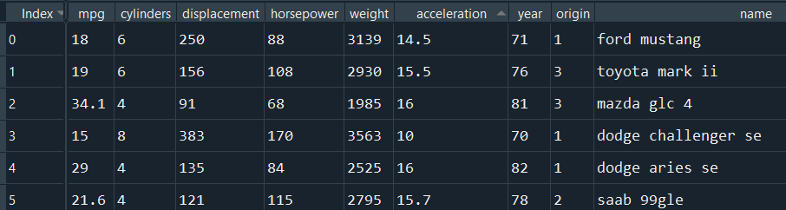
Exercise: Predicting miles per gallon
Dataset: Auto.csv
Objective: To predict miles per gallon; recall we can use polynomial regression, regression splines, and GAMs
Dependent Variable: Miles per gallon (mpg)
Independent Variables: Cylinders, displacement, horsepower, etc.
Notes:
Use the models presented here on the car dataset to predict miles per gallon. Recall we can use polynomial regression, regression splines, and GAMs.

Slide 48
Moving Beyond Linearity

Slide 49
Introduction to Machine Learning Course Roadmap
What is the goal of the data analysis?
Predict an output |  |  |  |  |  | Reveal patterns or relationships |  | Make decisions using an autonomous agent
Supervised Learning (Output in the data set) |  |  |  |  |  | Unsupervised Learning (No output in the data set) |  | Reinforcement Learning* (Supervised & unsupervised)
Continuous or discrete output? |  |  |  |  |  | What is the subgoal? |  | Does a model exist?
Continuous |  |  | Discrete |  |  | Identify groups | Reduce dimensions | Model Based | Model Free
Simple linear regression Multiple linear regression Subset selection Ridge regression & LASSO PCR & PLS | Polynomial regression Step functions Splines Local regression General additive models | Decision tree Random forest Neural network Gradient boosting tree | Logistic regression Linear discriminant analysis Quadratic discriminant analysis | Decision tree Random forest Neural network Gradient boosting tree | Support vector machines | Hierarchical clustering K-means clustering | Principal components analysis | Given the model Learn the model | Policy Optimization Q-Learning
Polynomial regression
Step functions
Splines
Local regression
General additive model
*Advanced Topic: Bonus module if time
Notes:
In the previous module, we reviewed concepts related to improving the linear regression model. We are now going to move beyond linearity and look at a set of nonlinear modeling techniques

Slide 50
Now you should be able to:
Identify types of non-linear models
Describe the general idea behind each of the common non-linear models
Identify when you might use each type of non-linear model
Explain what is meant by general additive model
Implement common non-linear model methods in Python

